Slide 1
Customer Buying Pattern Study
Jai Holkar (Task 1)

Slide 2
Objective
Summarize the findings on customer buying pattern by exploring the customer transaction data collected from recent online and in-store sales
Provide Recommendations based on findings.

Slide 3
Data Source Information
Following attributes were analyzed for 10000 customer purchase transactions
Type of Purchase
Online
In-store
Age of Customer
Grouped (> 35, 35-50, 51-68, >68)
Number of Items Purchased
Amount spent per transaction
Grouped in 3 bins (0-1000, 1000-2000, > 2000) for ease of analysis
Region of Purchase
East
West
South
Central

Slide 4
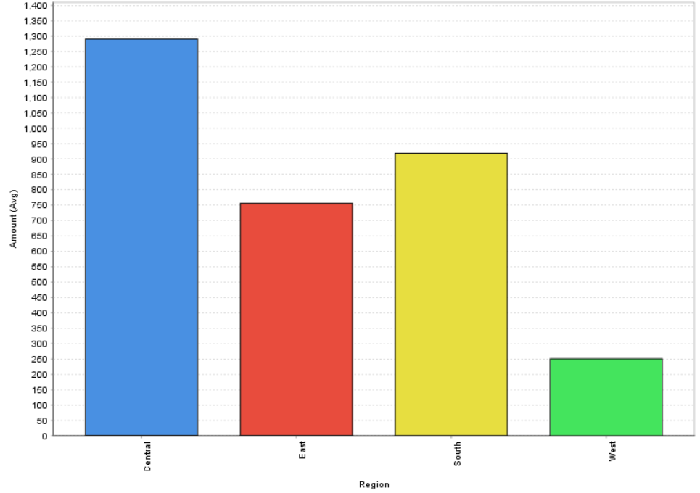
Buying Patterns - Spend By Region
Question: Do customers in different regions spend more per transaction? Which regions spend the most/least?
Answer: Yes
Findings:
Central Region spends most at average spend $1,280 per transaction.
West region spends least with average spend $250 per transaction.

Slide 5
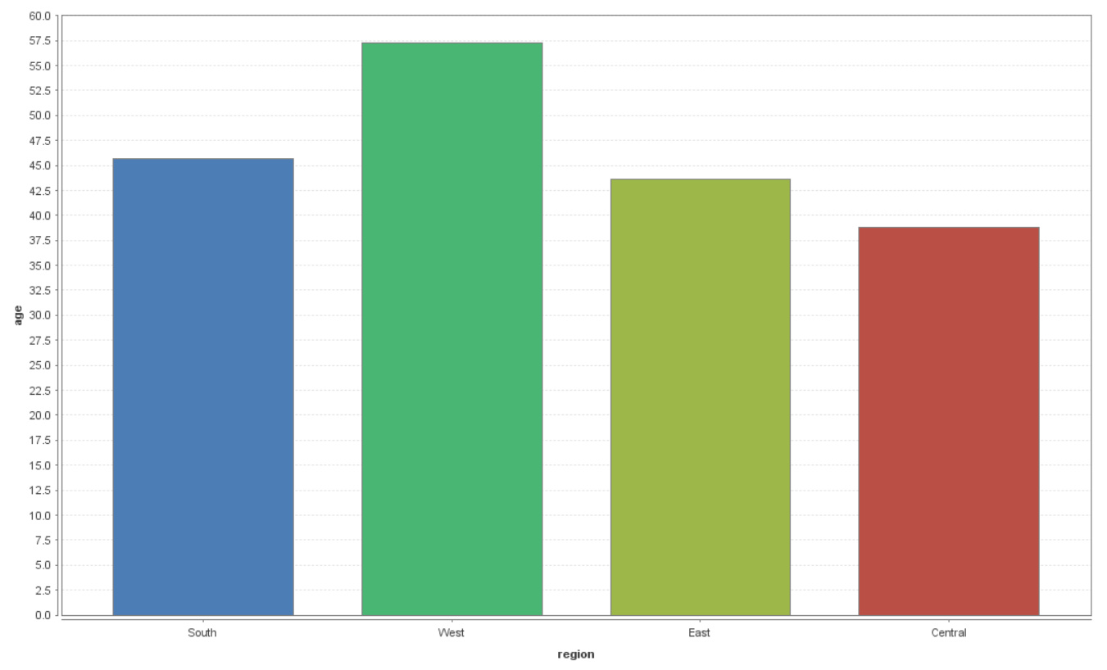
Buying Patterns - Spend by Region and Age of Customer (1)
Question: Are there differences in the age of customers between regions? If so, can we predict the age of a customer in a region based on other demographic data?
Answer: Yes, there are some difference in average age of consumers by region.
Yes, information such as purchase type (online vs. instore, amount of transaction can be used to predict the age of a customer in region to some extent.
Findings:
Average age of customer in West region is higher than other regions.
Using decision tree to predict the region (see next slide):
Customers with age > 75 are mostly from West Region
Customer making in-store purchase of less than $1,000
And age between 23 and 75 likely to be from South region
And age less than 23 are likely to be from Central region
Customer making in-store purchase of less than $1,000
And age between 27 and 75 likely to be from West region
And age less than 27 are likely to be from Central region

Slide 6
Buying Patterns - Spend by Region and Age of Customer (2)

Slide 7
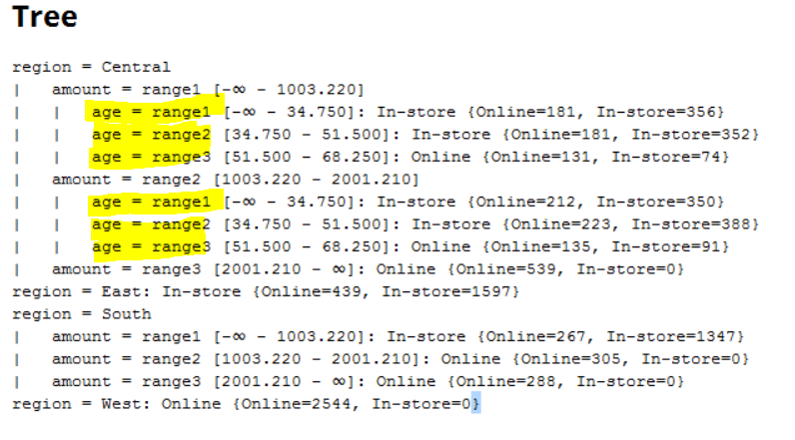
Buying Patterns - Online vs. In-store Prediction (1)
Question: Is there any correlation between age of a customer and if the transaction was made online or in the store? Do any other factors predict if a customer will buy online or in our stores?
Answer:
Age of customer helps predict type of purchase for central region for transaction amount less than $2,000.
Region and transaction amount are other factors help predict online or instore purchase.
Findings:
Nearly 100% of Customer in West region are likely to make online purchase.
Majority of East region customers prefer in-store purchases.
Central region, customers with age > 50 most likely to make purchases online.
Central region customers prefer purchasing higher value (> $2000) online.
Southern region customer are more likely to purchase items with value $1,000 or more online

Slide 8
Buying Patterns - Online vs. In-store Prediction (2)

Slide 9
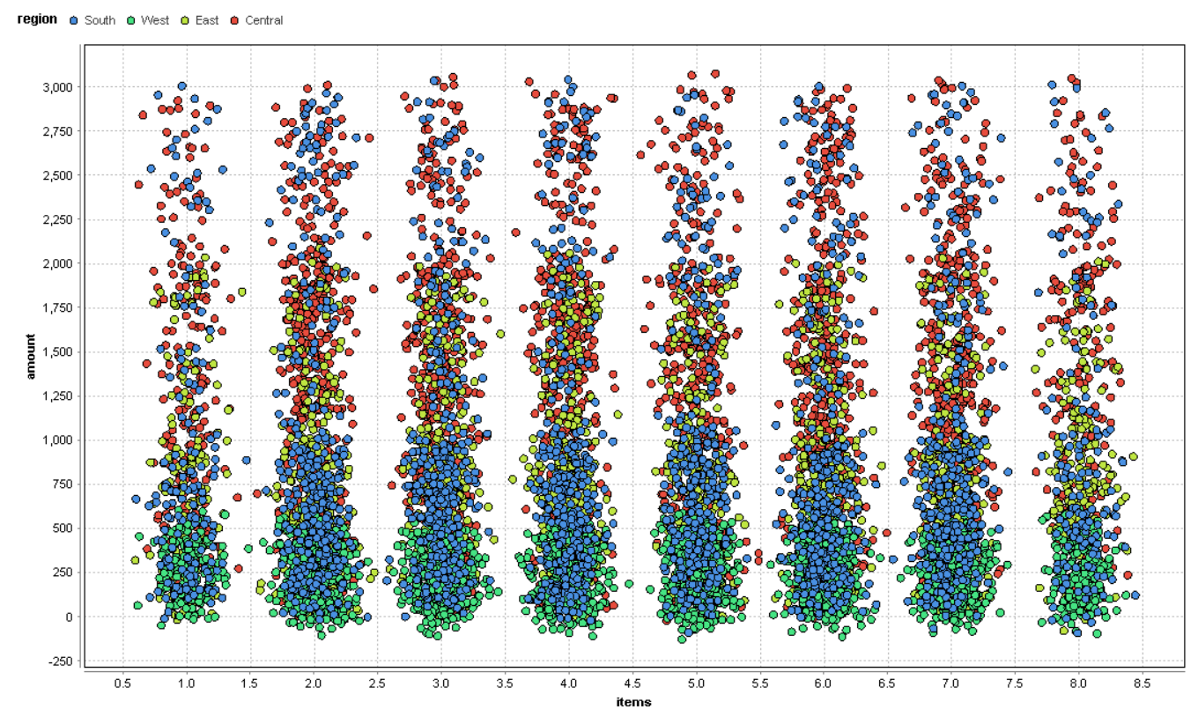
Buying Pattern –Items Purchased vs. Transaction Amount
Question: Finally, is there a relationship between number of items purchased and amount spent?
Answer: No
Findings:
There is no observed correlation between number of items purchased and amount spent.
If we consider region, the no. of items are evenly spread with central region customer buying higher value items and West region customer buying lower value items.

Slide 10
Buying Patterns – Online vs. In-store Prediction Accuracy
Algorithm | Accuracy (Attribute – Instore) | Accuracy (Attribute – Items)
Decision Tree | 83.32% | 50.15%
Random Forest | 83.32% | 49.09%
Gradient Boosted | 83.27% | 49.52%
ID3 | 83.26% | 49.44%
The cross validation tool was used construct a trained models to access the accuracy.
Findings:
We can predict with 82 % accuracy where the transaction took place (online or in-store) using region, amount of transaction and age.
No . Of items purchased and transaction amount does seem be the correlated and models accuracy is below 50%

Slide 11
Recommendations
Blackwell Electronics to consider following
Focus on online marketing and sales for
Customers in west region
Central region customers with age > 50 years
Higher value items (> $2,000) for Central region customers
Focus on in-store marketing and sales for
Customers in east region

Slide 12
Leveraging Data Mining for e-Business
Data Mining can be utilized to see patterns, make predictions, take action, measure results, and correct courses to optimize strategies.
What? | How? | Why?
What prospective customers are seeking from a site? Are they purposefully shopping or just browsing? Buying something they’re familiar with or something they know little about? Are they shopping from home, from work, or on the move? | Customer Profiling Use Data Mining tools that take care of knowledge representation of customer profiles and predictive modelling of scenarios of customer interaction. | Predicting buyer behavior will improve the availability of products and services and hence the profits. Use the purchase information for capacity planning and infrastructure integration
How customers may respond to promotional offers | Recommendation systems Develop event-prediction system based on association rule-mining and clustering algorithms | Ability to not only notify customers of events, but also to predict events and event classes that are likely to be triggered by customers. To forecast the demand of product categories better.

